Slide 1
Checkpoint Mongo DB
Ben Alaya Ala

Slide 2
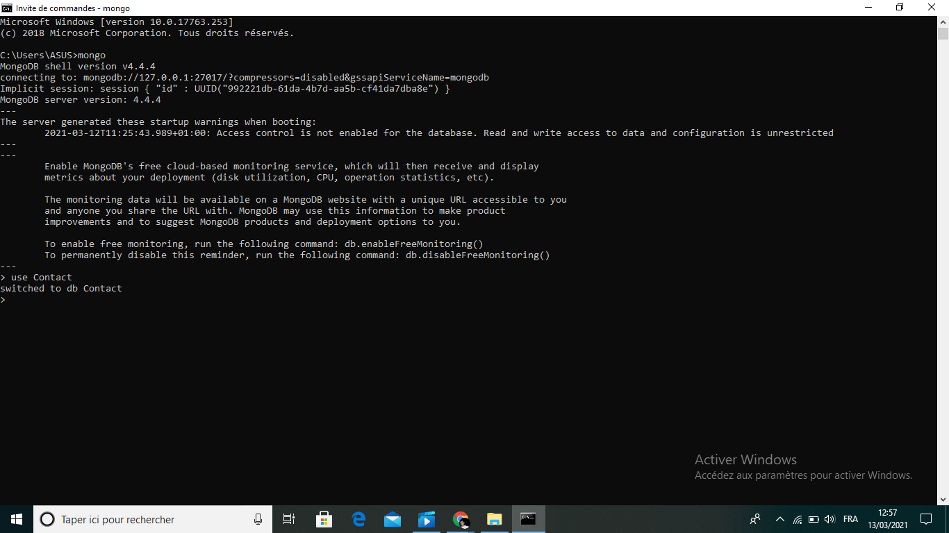
Create a database called "contact"

Slide 3

Create a collection called "contactlist"

Slide 4
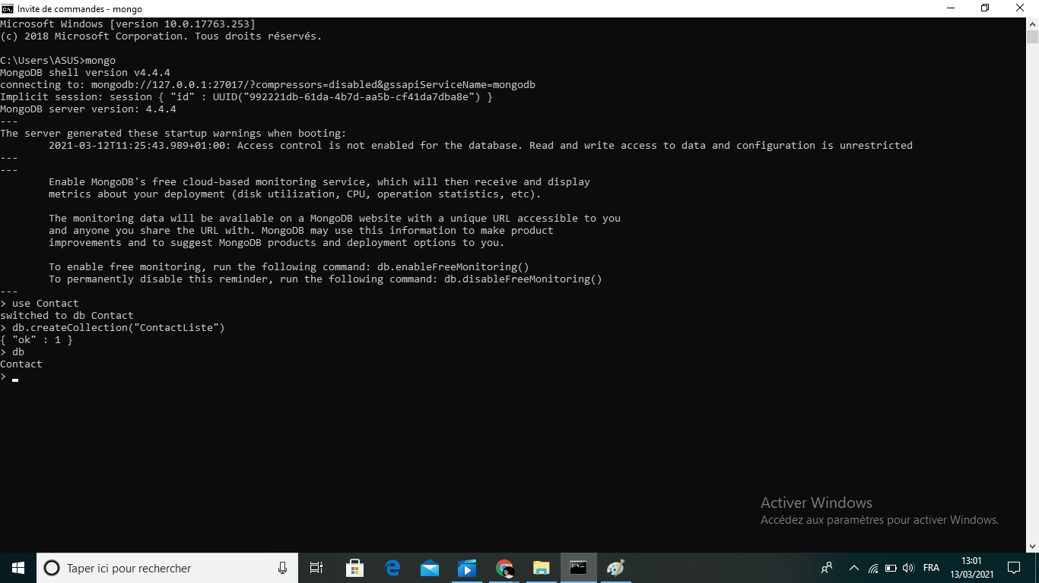
Create a collection called "contactlist"

Slide 5
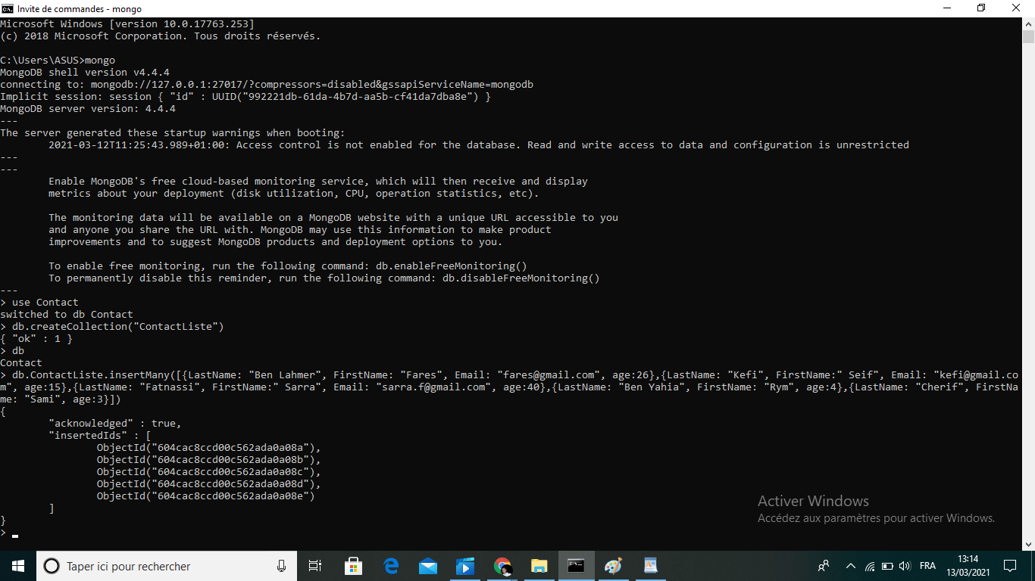
Insert these documents in "contactlist"

Slide 6
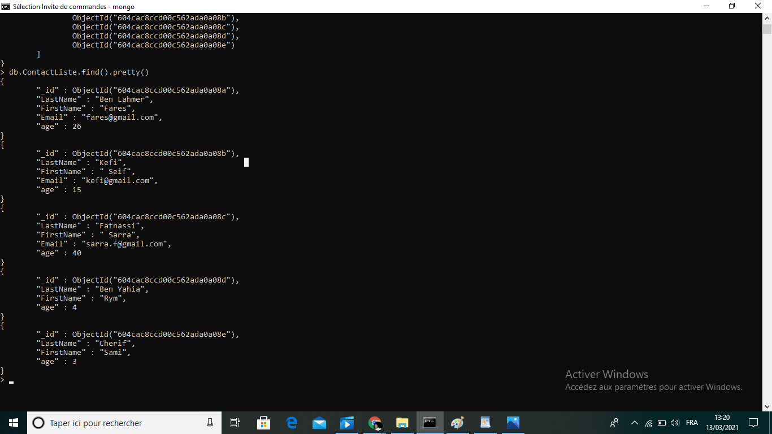
Insert these documents in "contactlist"

Slide 7
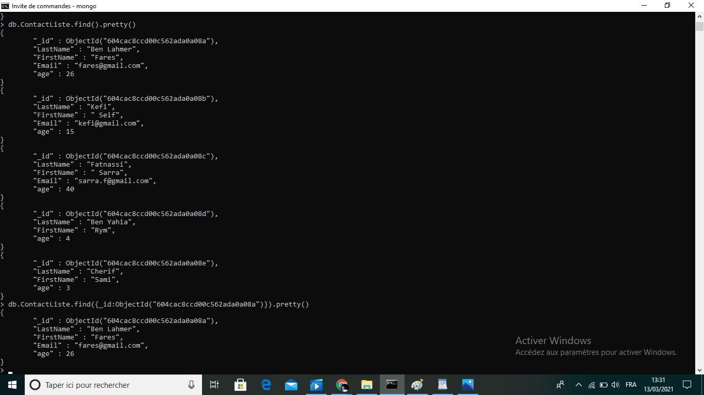
Display all the information about only one person using his id

Slide 8
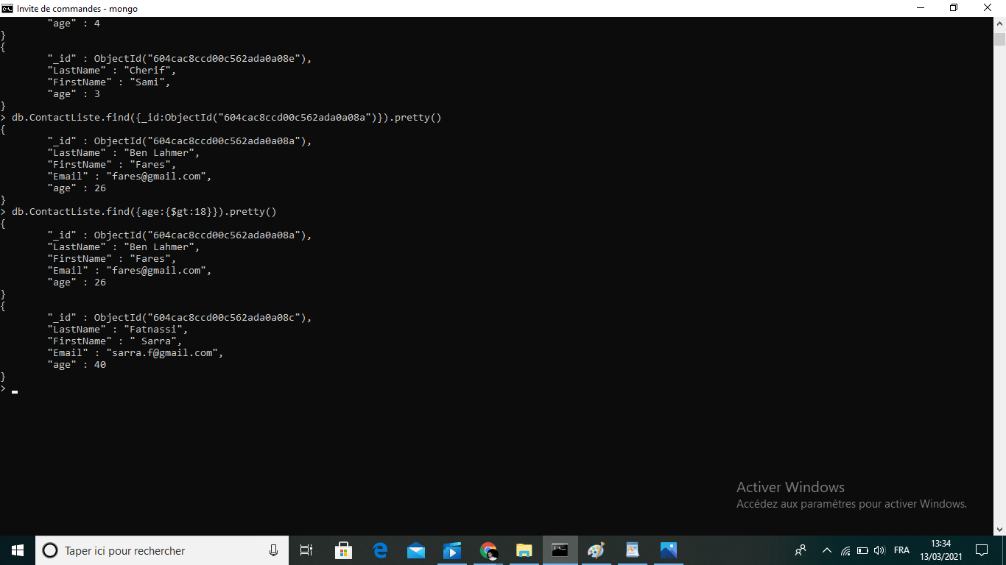
Display all the contact list having age>18

Slide 9
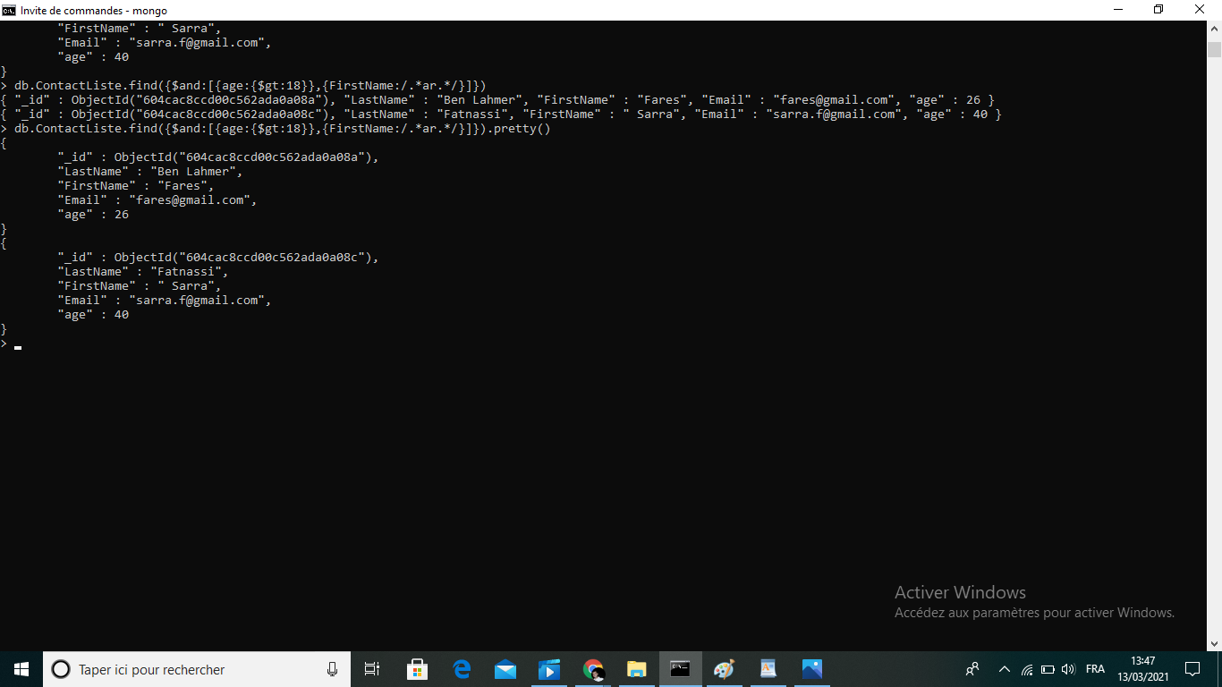
Display all the contact list having age>18 and name containing "ar"

Slide 10
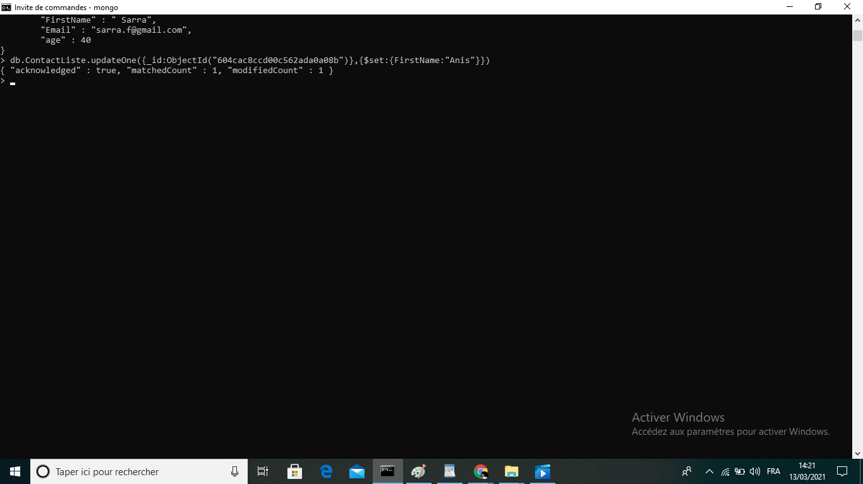
Change the contact first name of "kefi Seif" by "Kefi Anis"

Slide 11
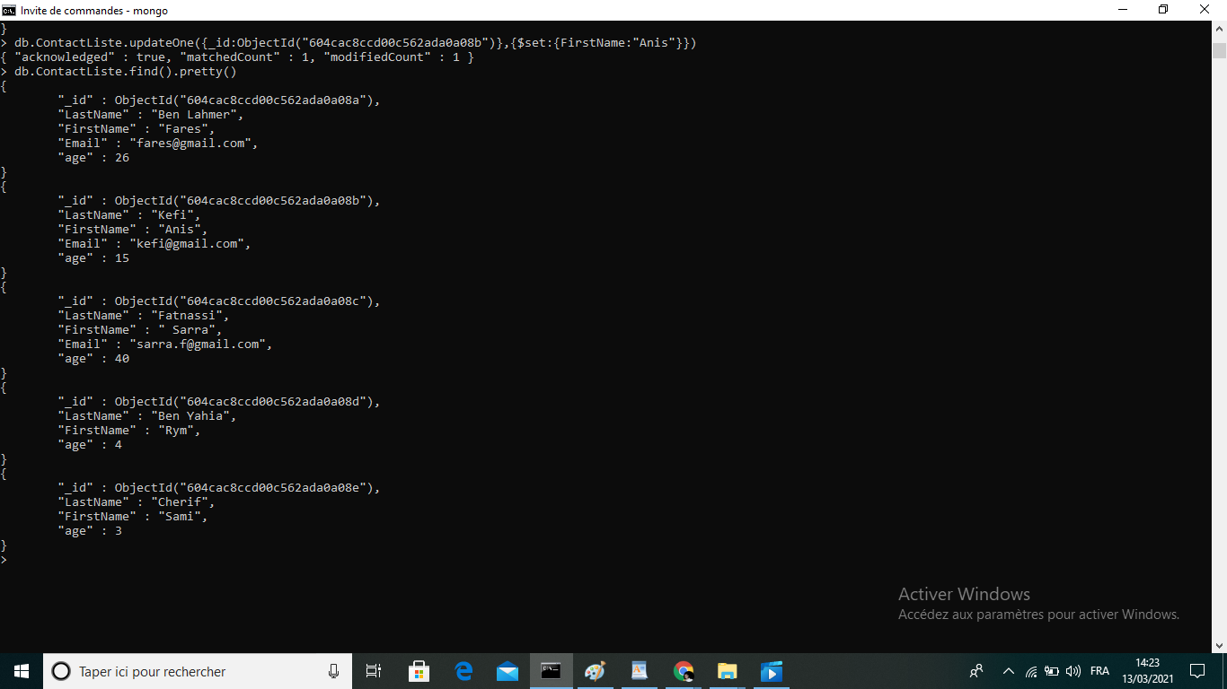
Change the contact first name of "kefi Seif" by "Kefi Anis"

Slide 12
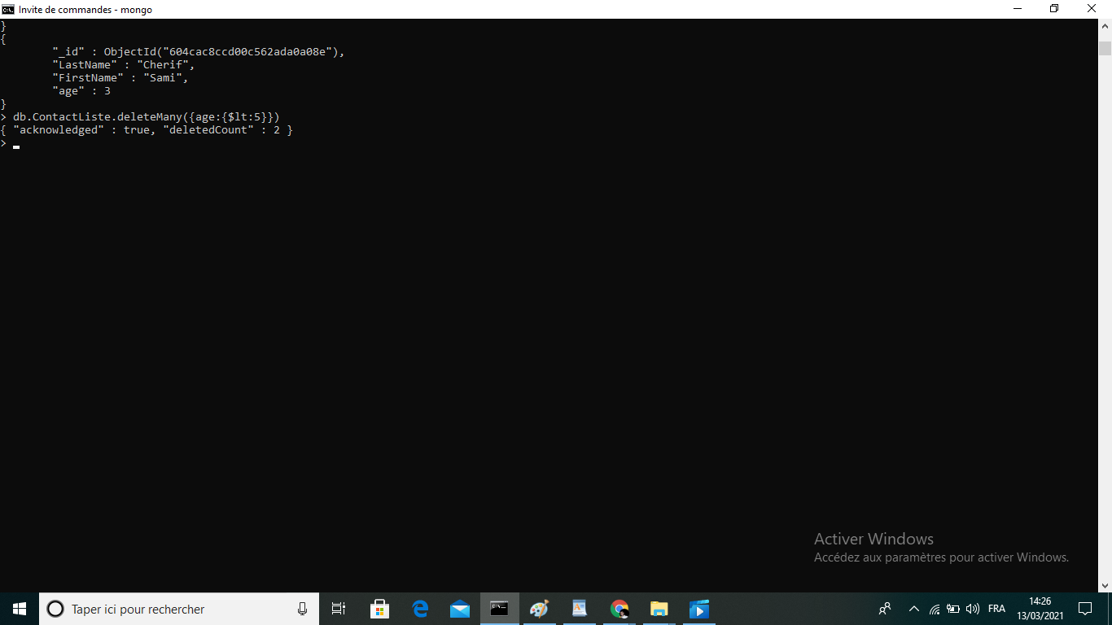
Delete the the contact list having age < 5

Slide 13
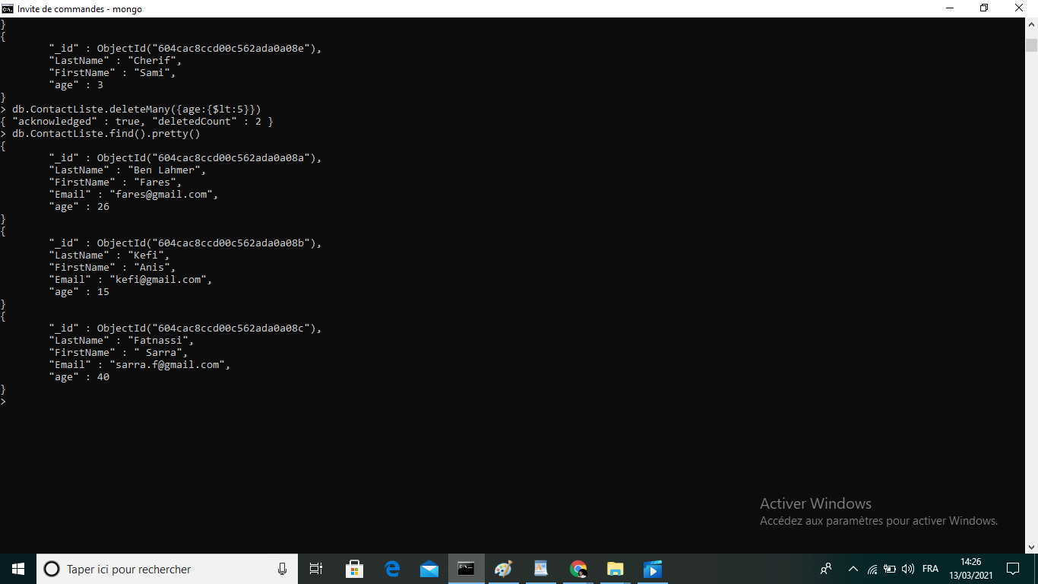
Display all the contact list

